Slide 1
LipoMicel: The Science behind the Technology
Julia Solnier, Ph.D.
Director, Medical & Scientific Affairs
www.isura.ca

Slide 2
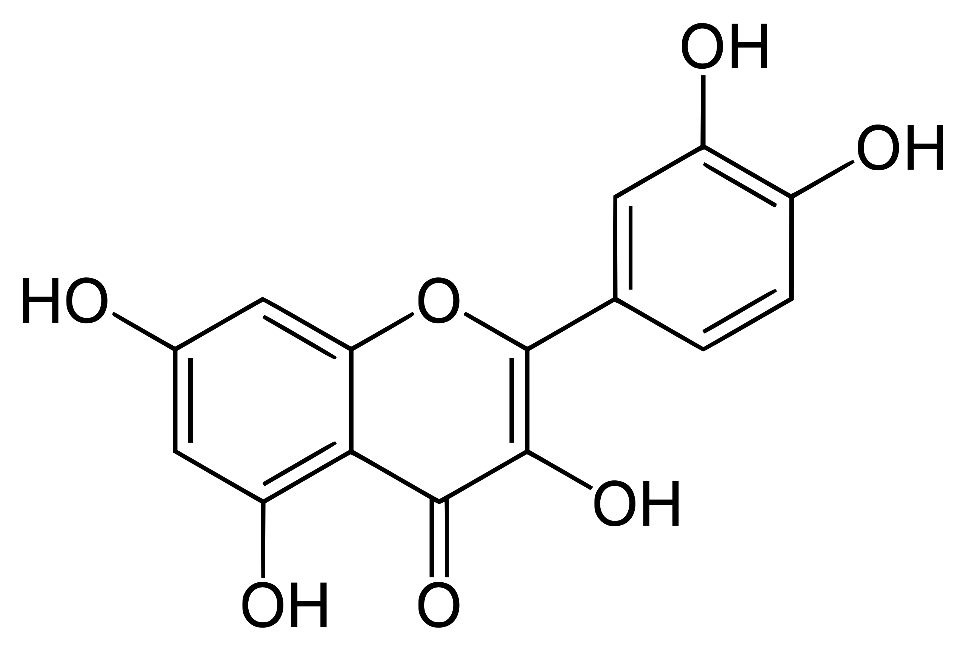
What is Bioavailability?
In nutritional science: “the fraction (%) of the ingested dose that is absorbed”
Many natural compounds are poorly absorbed
due to intestinal endothelium absorption and first-pass metabolism
great variability between individuals in terms of absorbing nutrients
Quercetin
3,3′,4′,5,7-Pentahydroxyflavone
C₁₅H₁₀O₇
M= 302.236 g/mol
Sophora japonica -> isolated compound
www.isura.ca

Slide 3
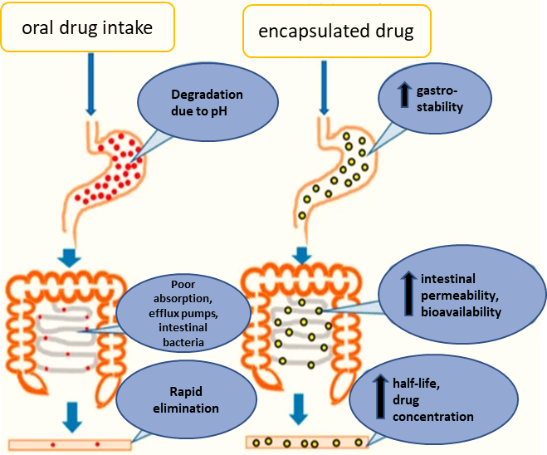
Factors affecting Bioavailability:
Physical properties of the substance:
solubility, molecular size
formulation (delivery system, liquid, powder, or solid)
interactions with foods (administered in a fed or fasted state)
Individual differences:
Age, ethnicity, gender
Diet (e.g., microbiome/gut bacteria)
Genetic variations (e.g., metabolic and enzymatic differences)
Health status (e.g., gastrointestinal conditions, hepatic or renal dysfunction)
Use and interaction with drugs (e.g., antacids, alcohol, nicotine)
www.isura.ca

Slide 4
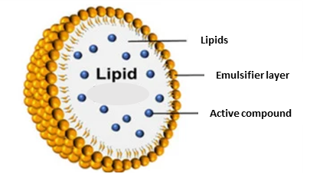
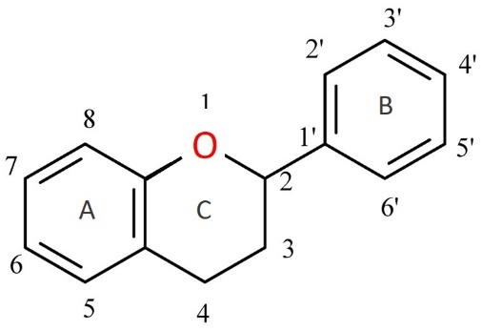
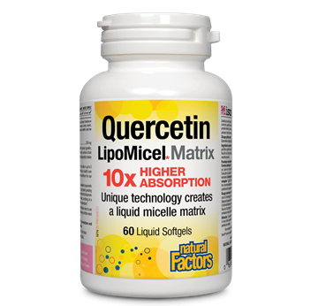
Delivery systems
a carrier for bioactive compound(s) to cross cell membranes and improve cell uptake
requires both water & fat solubility + small molecular size
Advantages of Encapsulation:
small molecular size (micro- or nanometer)
improved solubility & stability (pH sensitivity): no early degradation in the stomach
protection against extensive metabolism (gut bacteria, enzymes, etc...)
prolonged half-life
lower dose & side effects
www.isura.ca

Slide 5
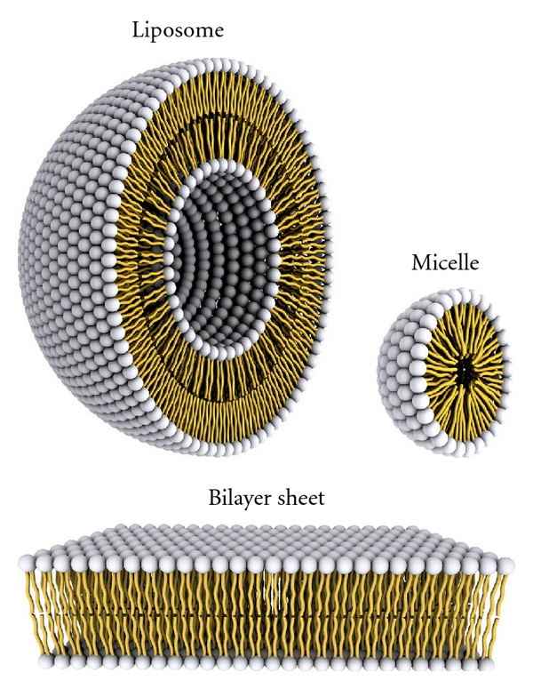
LipoMicel vs LipoSomes
amphiphilic molecules:
hydrophilic “water-loving” & hydrophobic “water-repelling” components
Micelles:
composed of monolayer of amphipathic molecules:
inner core hydrophobic; hydrophilic outer layers
formed by aggregation of surfactant molecules (detergents, emulsifiers..)
smaller size than liposomes
Liposomes:
composed of bilayer of amphipathic molecules:
inner core hydrophilic; hydrophobic bilayers
formed by phospholipid molecules (e.g., lecithin), and cholesterol
https://doi.org/10.5402/2012/738432
www.isura.ca

Slide 6
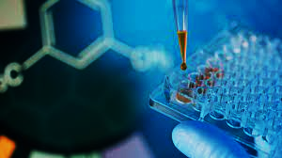
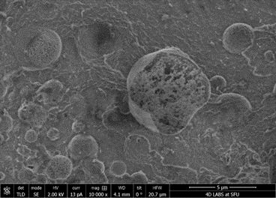
In-vitro Research
1. Solubility studies:
in gastric and intestinal media: mimicking the pH environment in the human body
predictor of absorption and bioavailability
2. Caco-2-cell studies:
a cell line derived from human colon carcinoma
similar characteristics to cells lining the small intestine
used for permeability, absorption, interactions, toxicity & safety studies
3. Characterization of the LipoMicel particles:
particle size distribution: Dynamic Light Scattering (DLS)
stability: Zeta potential
morphology, size, and shape: Scanning Electron Microscopy (SEM)
Atomic force microscopy quercetin in LM in 3-D representation
Cryo-SEM shows berberine present inside the micelles of LM
www.isura.ca
Chuck

Slide 7
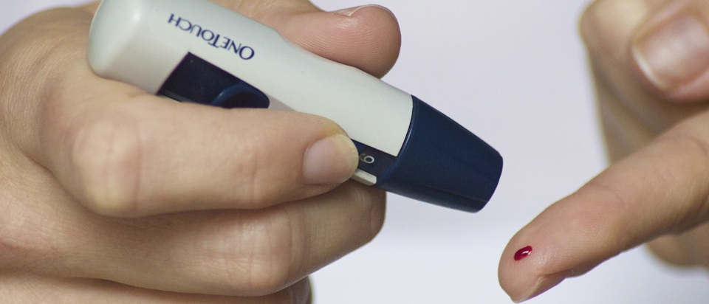
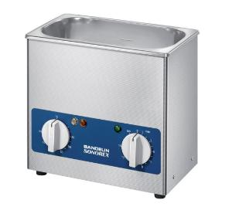
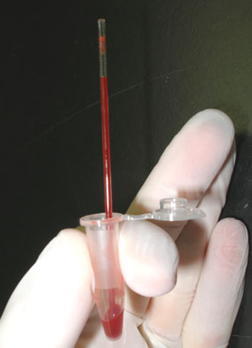
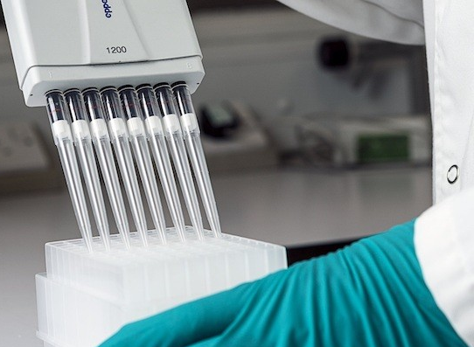
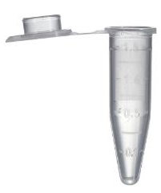
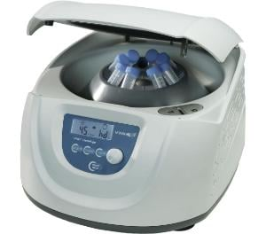
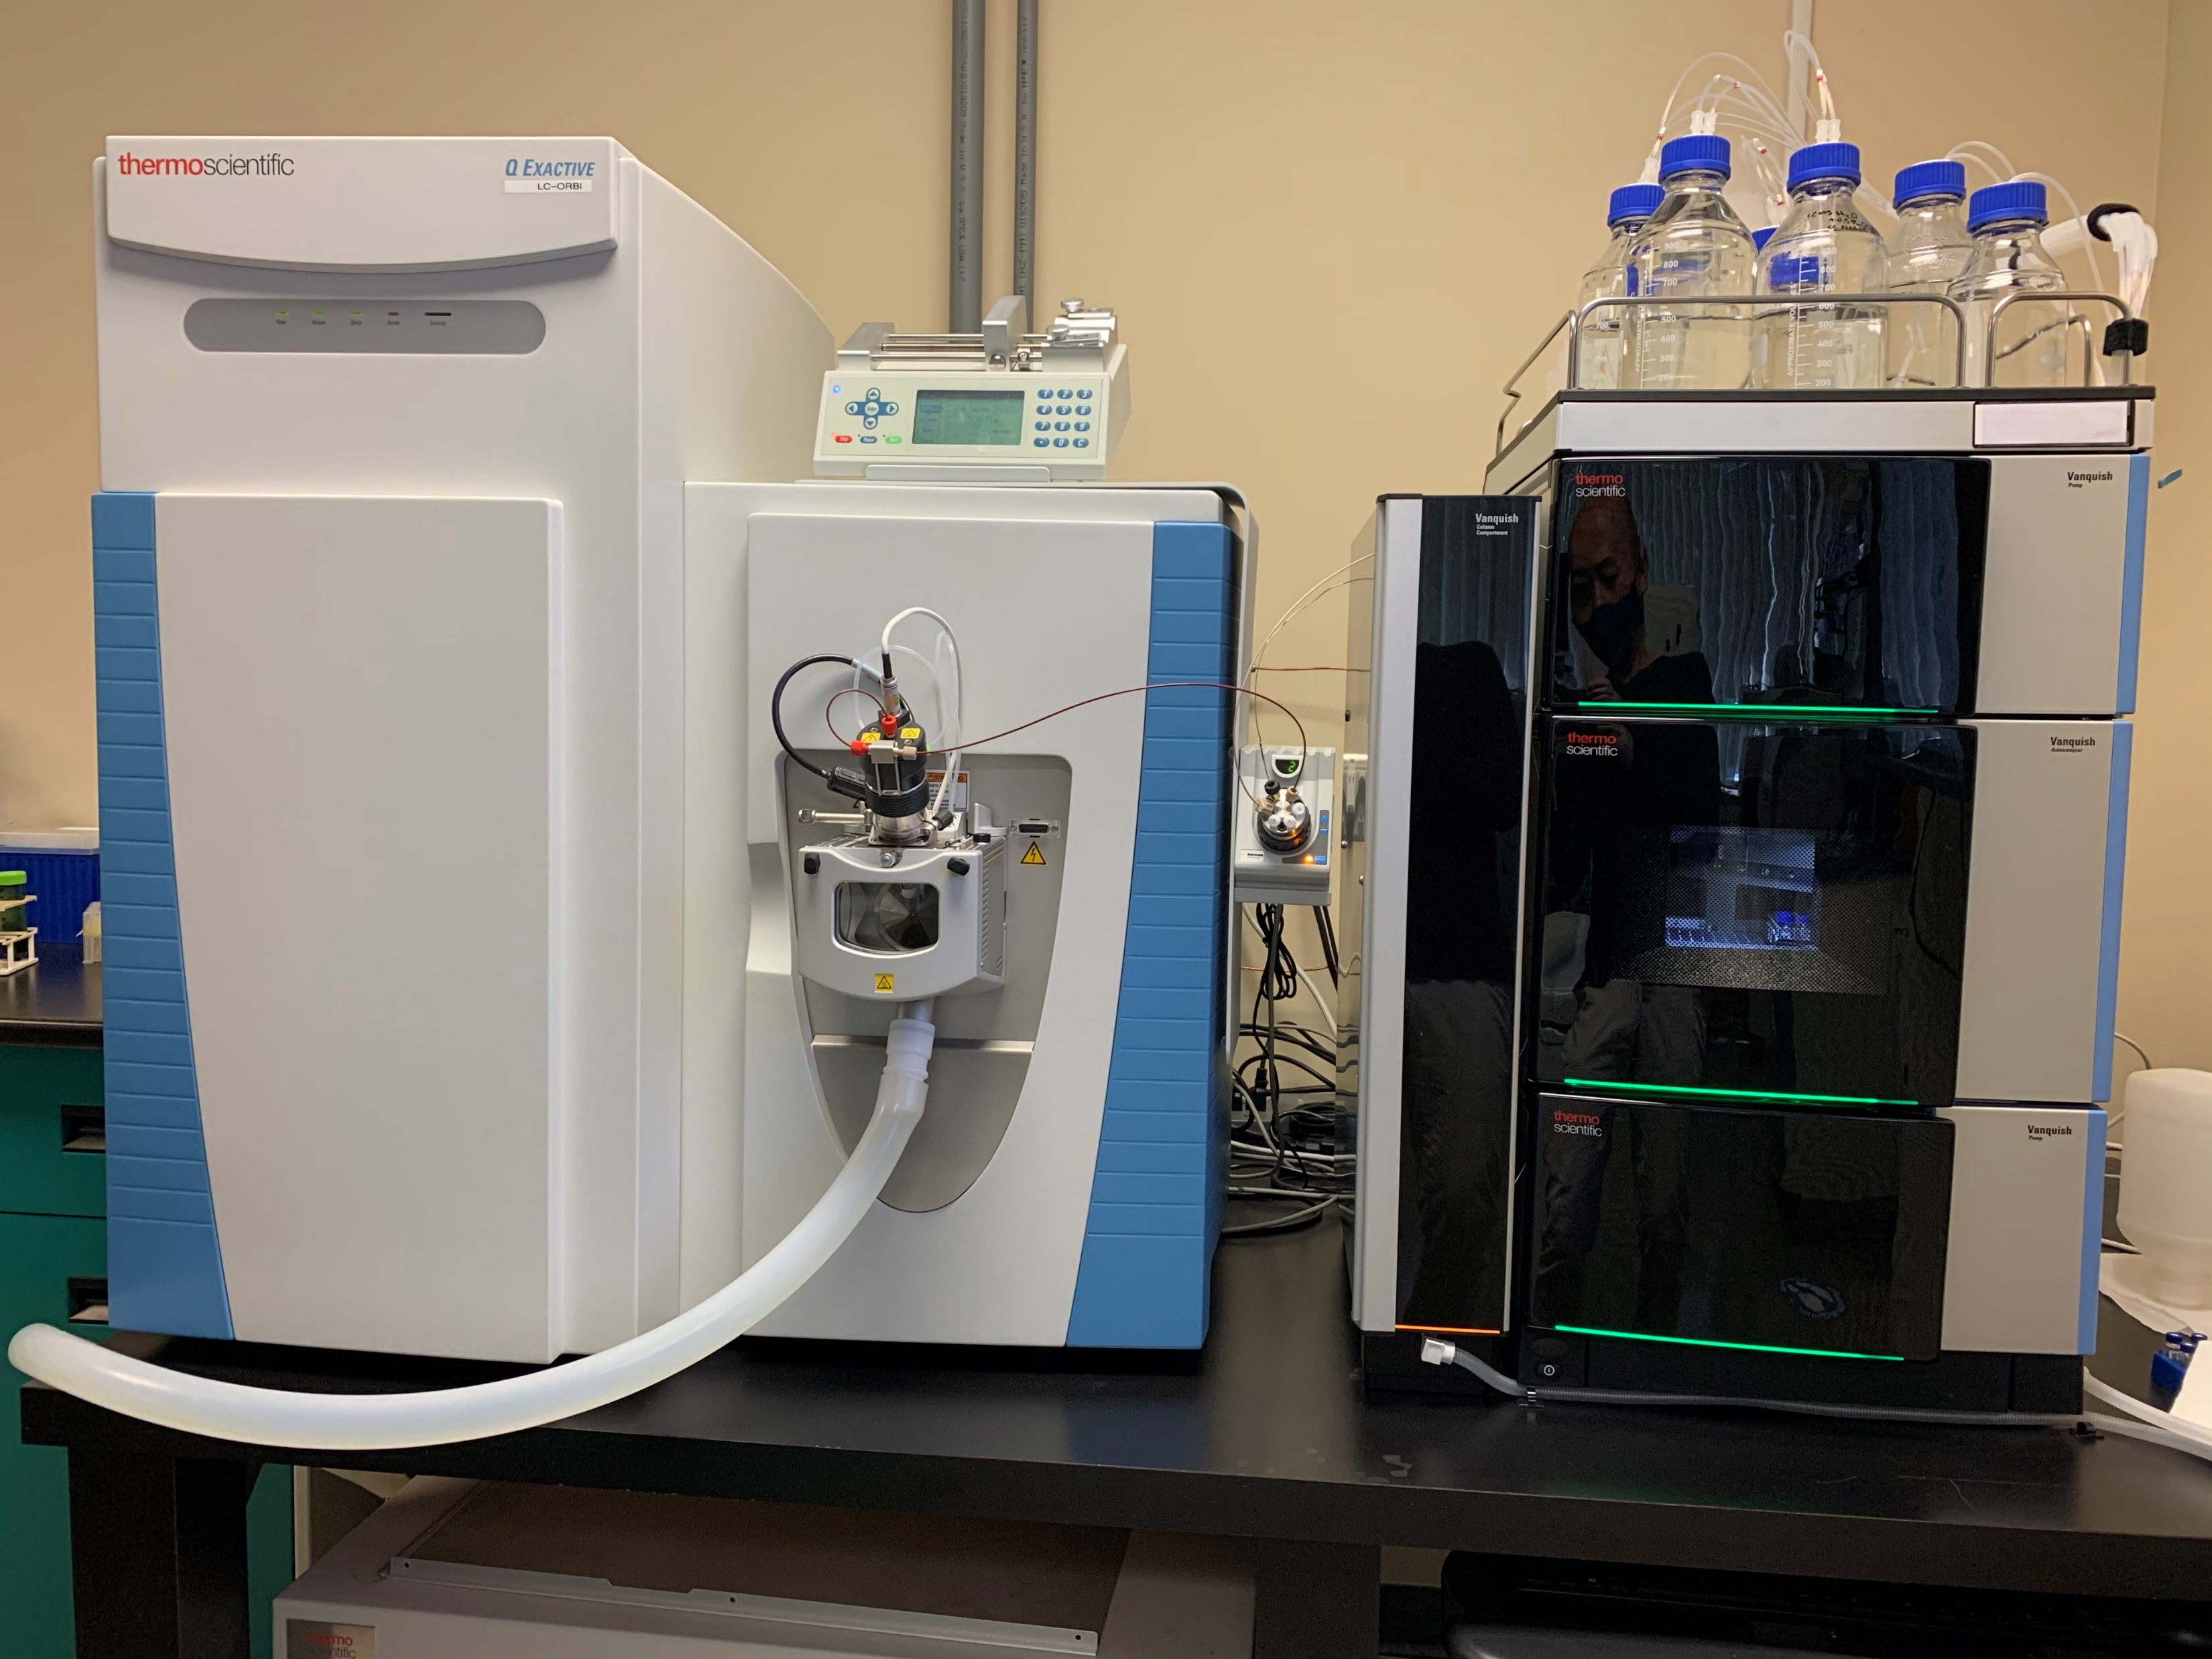
Clinical Research
1. Bioavailability studies in humans:
to measure the absorption of a compound in LipoMicel formulation
to compare it with standard (unformulated) product + competitor formulations
Methods:
Crossover studies with 10-15 participants
Treatments administered in fasted or fed state
Collection of capillary blood samples at intervals from 0-24hrs or longer
high-resolution analyzer: UHPLC coupled to Orbitrap Mass Spectrometer
β-glucuronidase
ethanol
Sample preparation
www.isura.ca
Chuck

Slide 8
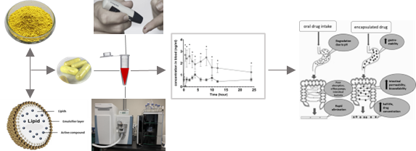
Clinical Research
2. Safety studies in humans:
to monitor adverse events or side effects of LipoMicel formulations
Surveys/health questionnaires as well as blood collections over 2 or 4 weeks
Methods:
Placebo-controlled, parallel study design
Collection of capillary and/or venous blood samples
Clinical chemistry: alanine aminotransferase (ALT), aspartate transaminase (AST), total bilirubin, creatinine, electrolytes (Na, K, Cl), & estimated glomerular filtration rate (eGFR)
www.isura.ca
Chuck

Slide 9
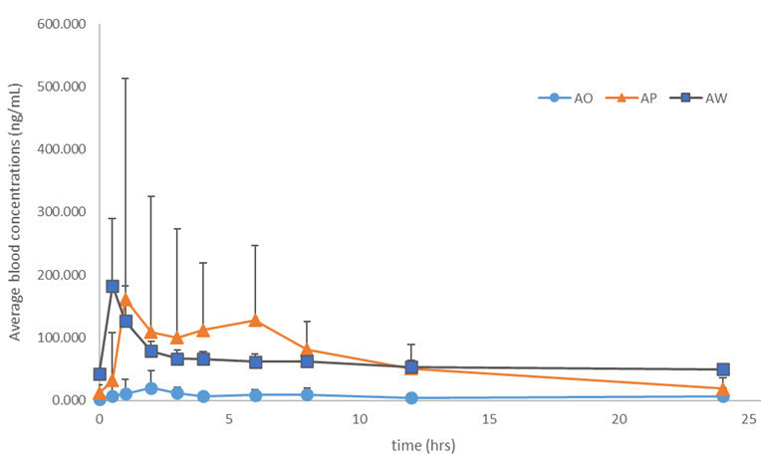
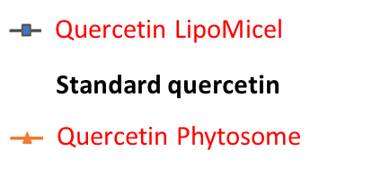
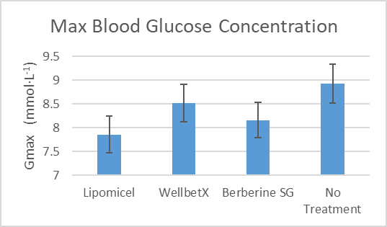
Results
1. Quercetin LipoMicel
10-fold higher concentrations of LipoMicel (LM) vs standard
Accumulating concentrations over 72hrs, at doses 250 mg, 500 mg, or 1,000 mg
2. Berberine LipoMicel
3-fold higher concentrations of LM vs standard
Higher gastrointestinal solubility (20-34-fold) and cell permeability
effective in lowering blood glucose levels by 12% in as short as 2 days
3. Glutathione LipoMicel
2-fold higher concentrations of LM vs Liposomal and standard
Approx. 2-fold higher metabolite concentrations γ-glutamylcysteine (γ-GC)
www.isura.ca

Slide 10
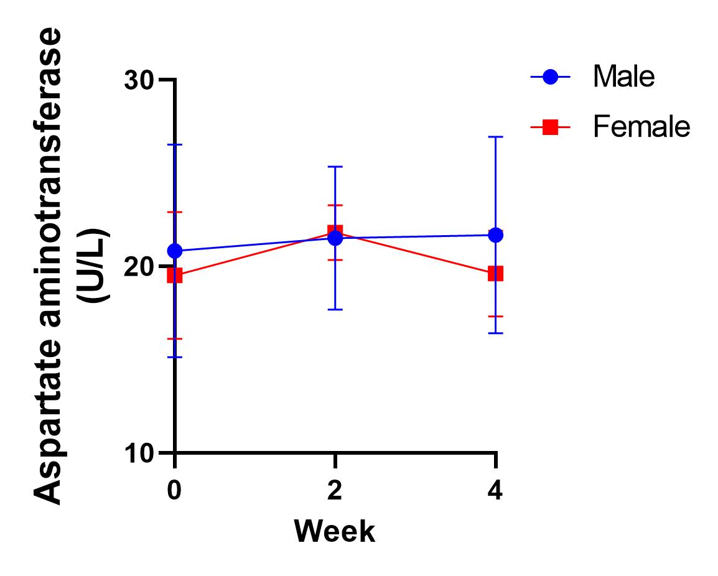
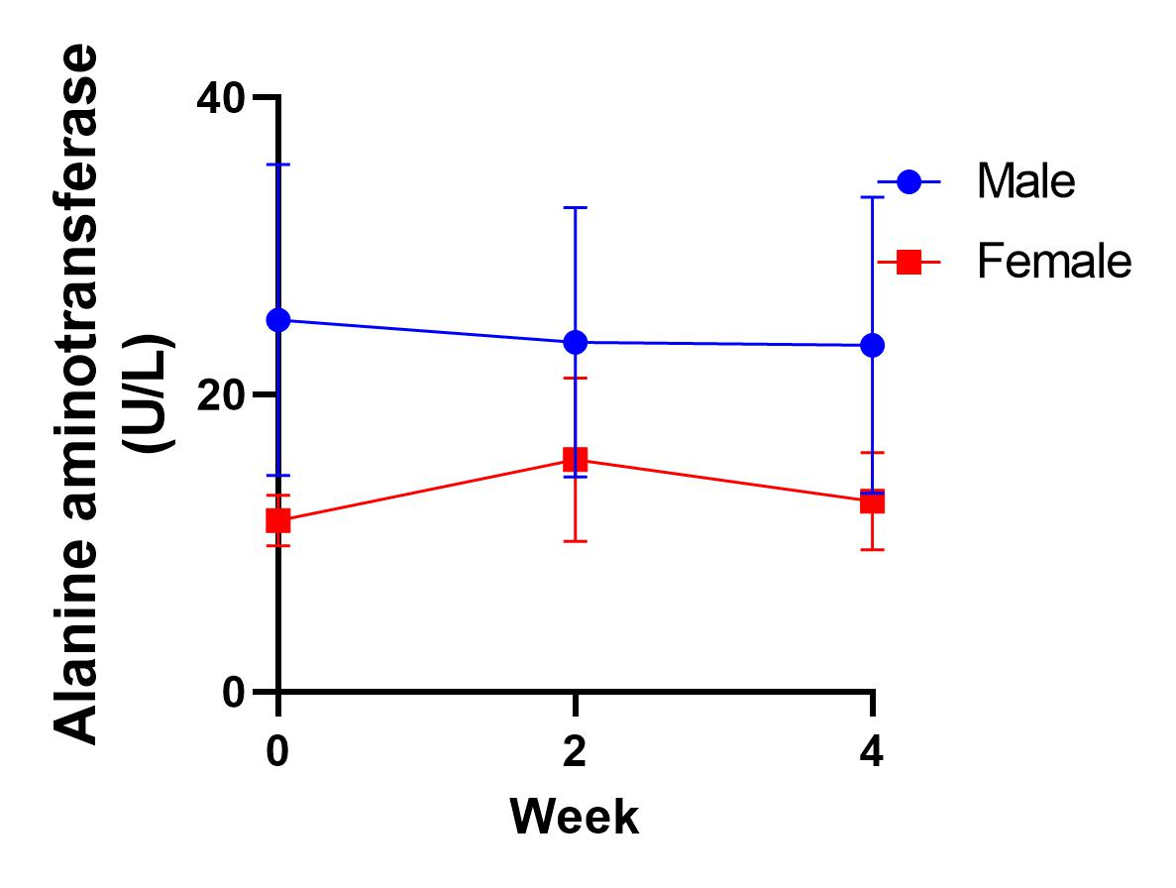
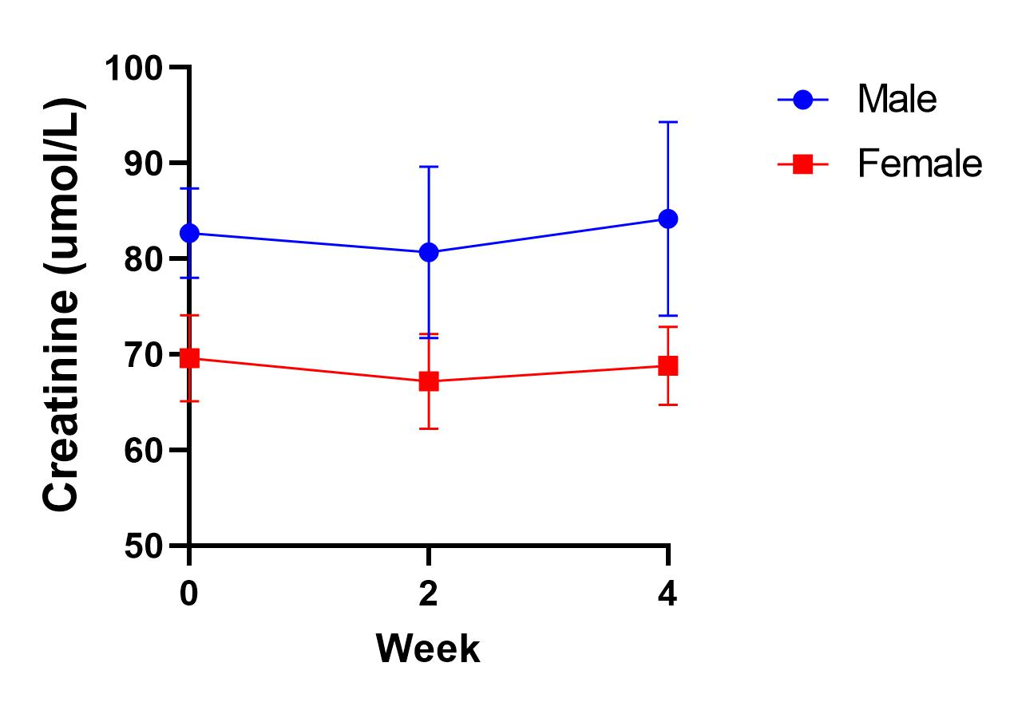
Results on Safety
No record of any adverse events and side effects during the 24-hr and 72-hr study periods.
1. Berberine LipoMicel
No significant changes in safety blood markers over a period of 30-days
No or mild gastrointestinal side effects after taking berberine for 30-days
2. Glutathione LipoMicel
No significant changes in safety blood markers over a period of 30-days
Mild gastrointestinal side effects after taking glutathione for 30-days
www.isura.ca

Slide 11
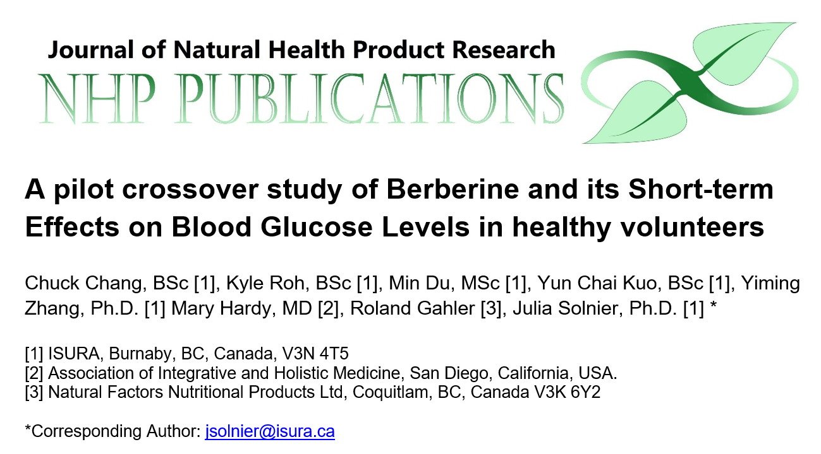
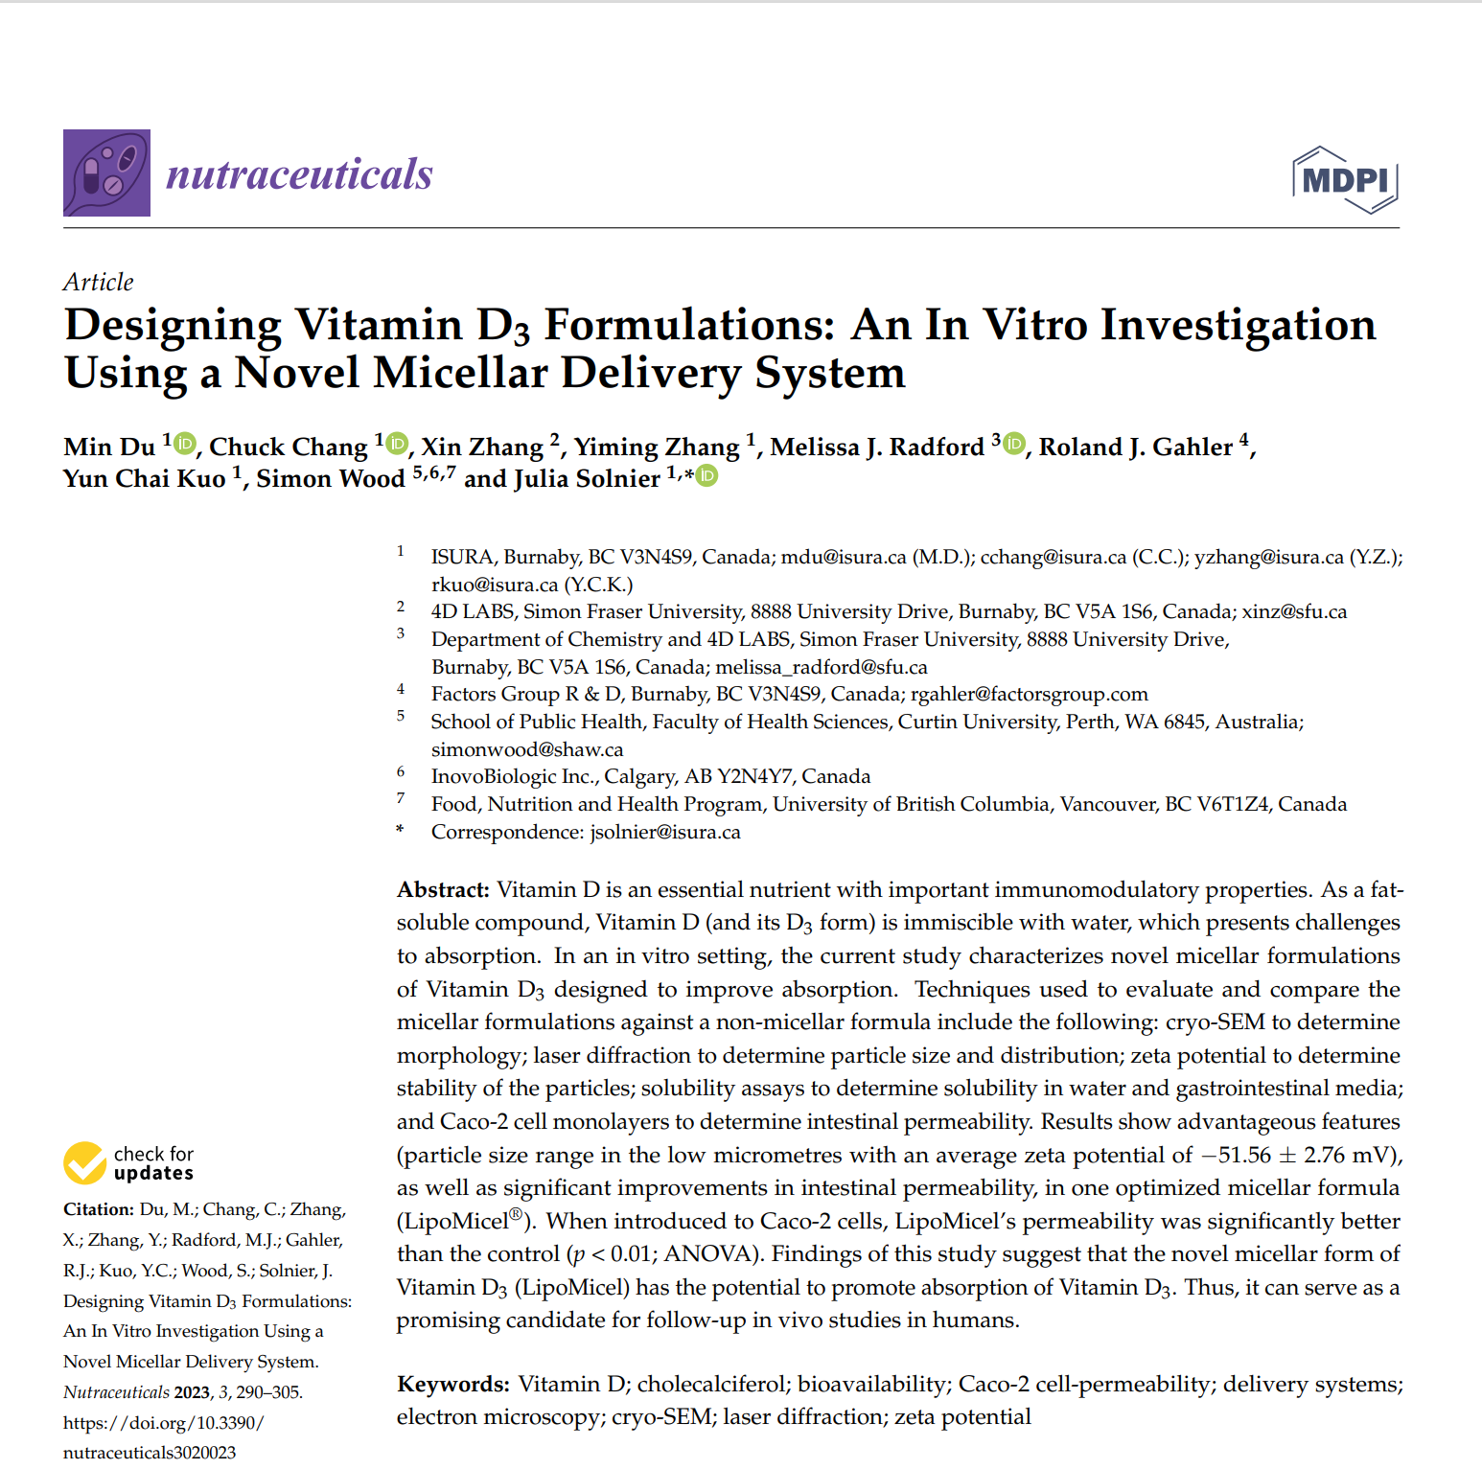
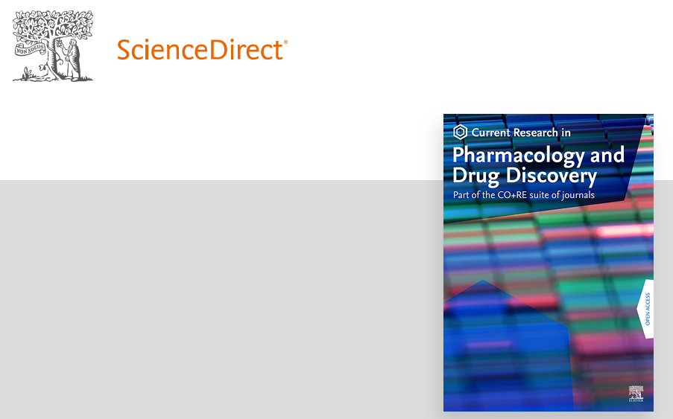
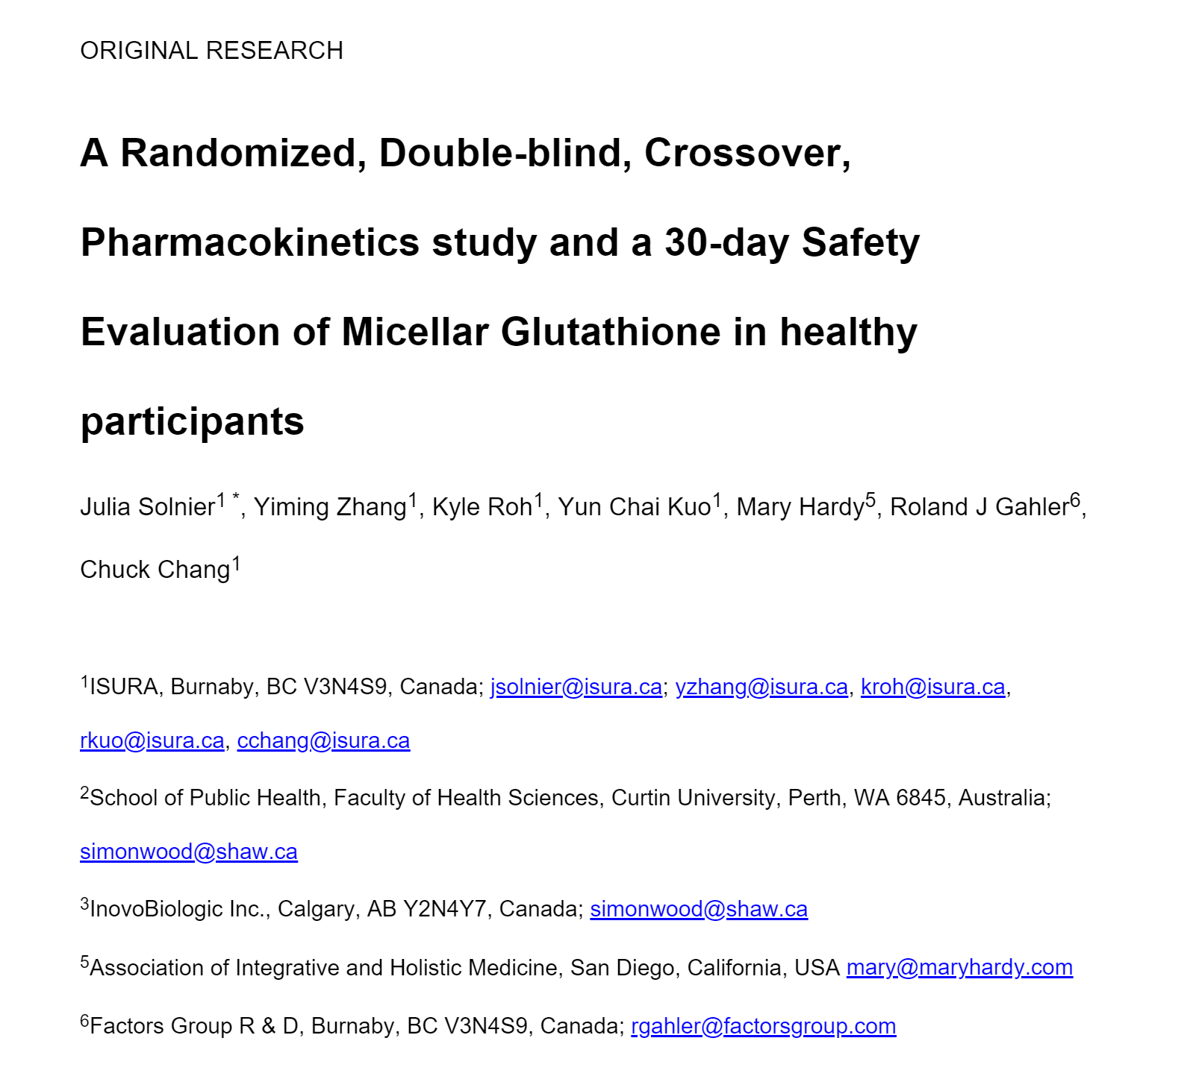
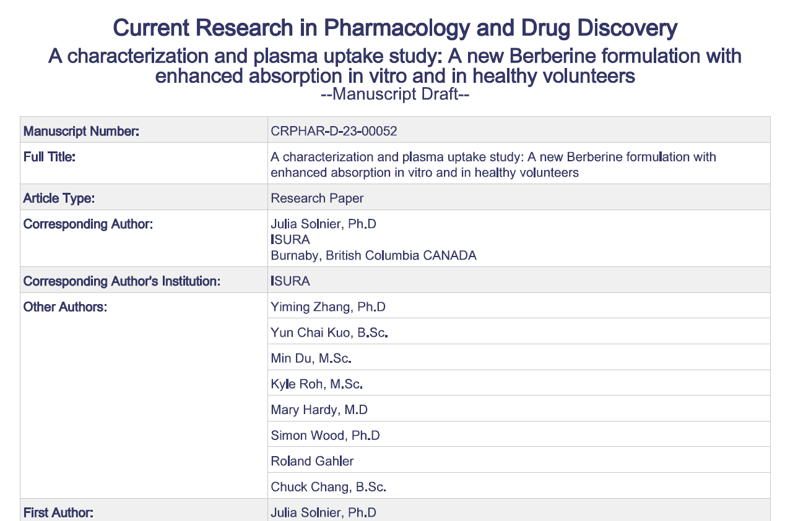
Research papers on LipoMicel products
www.isura.ca

Slide 12
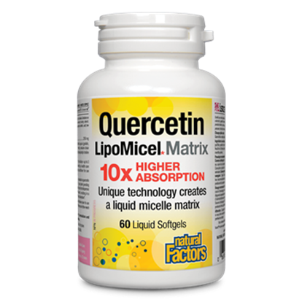
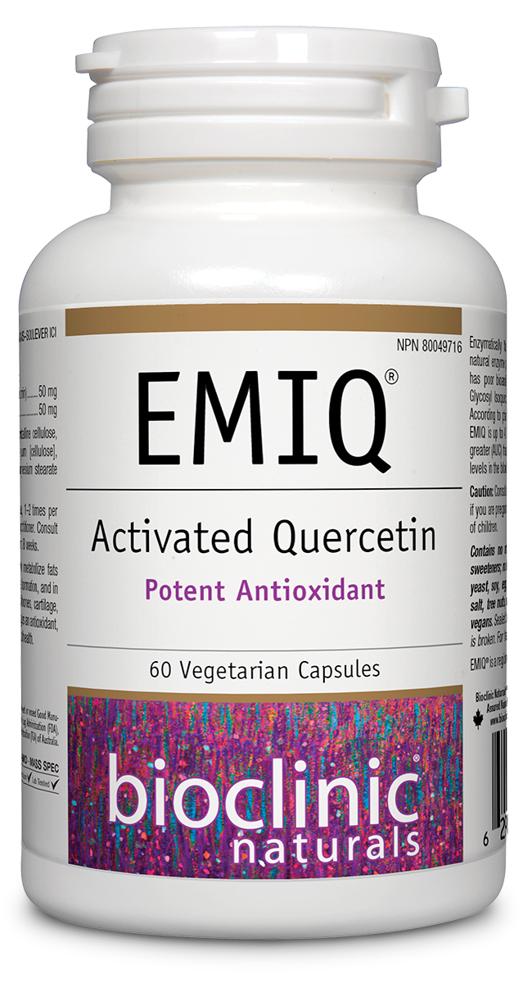
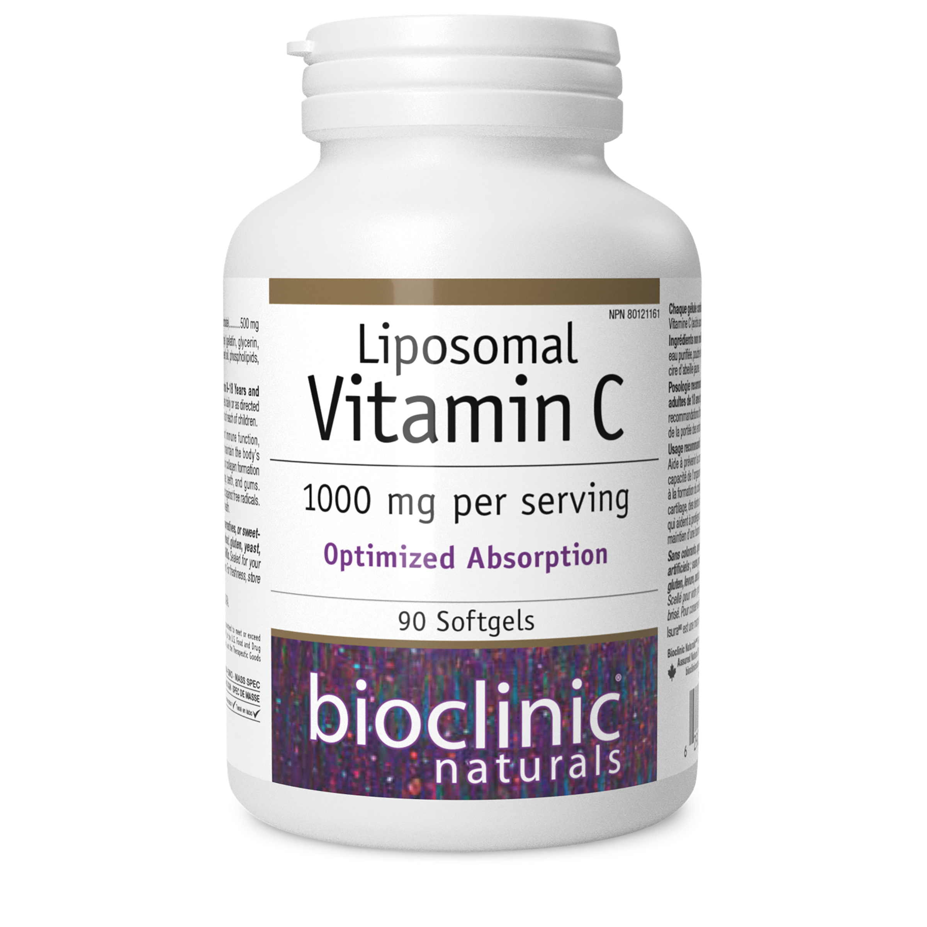
Frequent Questions
Lipomicel Quercetin vs EMIQ?
Micelles vs liposomes—which formulation works best?
Fat-soluble vs water-soluble compounds (like Vit C)
Soft gels vs liquids (in liposomal form)
www.isura.ca

Slide 13
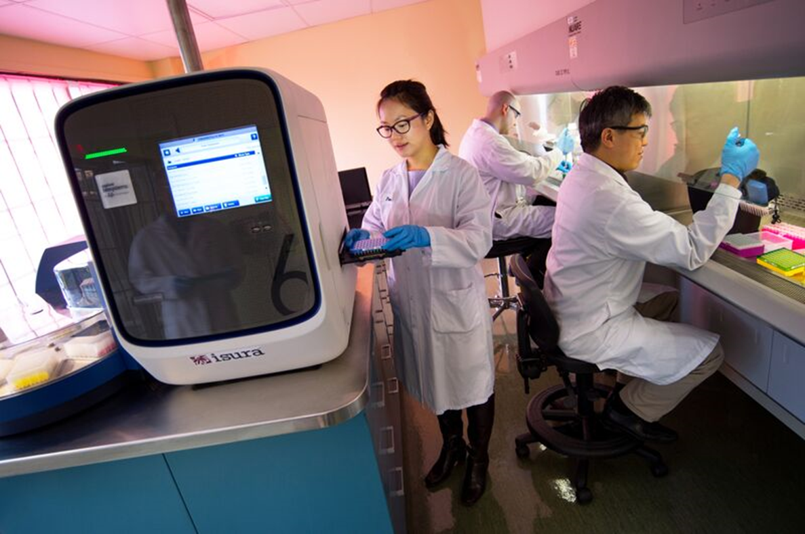
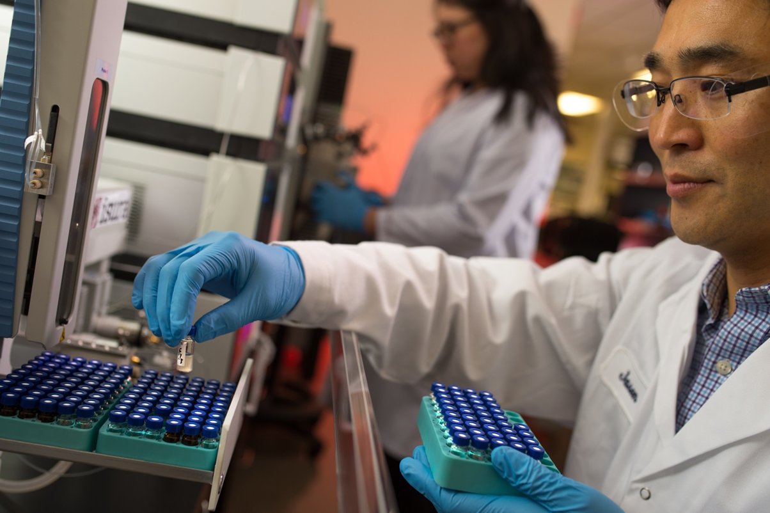
Thank you very much for your attention!
www.isura.ca

Slide 14
Study references:
Solnier et al. (2021) Quercetin LipoMicel—A Novel Delivery System to Enhance Bioavailability of Quercetin: https://doi.org/10.33211/jnhpr.17
Solnier et al. (2023) Pharmacokinetics of different Quercetin formulations in healthy volunteers: a diet-controlled, crossover, single- and multiple dose plasma uptake study (paper in revision)
Solnier et al. (2023) A characterization and plasma uptake study: A new Berberine formulation with enhanced absorption in vitro and in healthy volunteers (paper in review)
Chang et al. (2023) A pilot crossover study of Berberine and its Short-term Effects on Blood Glucose Levels in healthy volunteers (paper accepted for publication).
Solnier et al. (2023) A Randomized, Double-blind, Crossover, Pharmacokinetics study and a 30-day Safety Evaluation of Micellar Glutathione in healthy participants (paper in preparation).
Du et al. (2023) Designing Vitamin D3 Formulations: An In Vitro Investigation Using a Novel Micellar Delivery System: https://doi.org/10.3390/nutraceuticals3020023
www.isura.ca

